Slide 1
How did Life in Egypt affect Medicine?
Ancient Medicine

Slide 2
Ancient Medicine
3000BC – 500AD
Egyptians 3000BC-1000BC
Greeks 1000BC – 500BC
Romans 500BC – 500 AD
Key – examine patterns and themes across the period
Focus: Egypt

Slide 3
Egypt – A Wealthy Country
Wealthy country
Powerful rulers
Trade
Farmers
Writing
Led to various improvements in medicine

Slide 4
Specialists Doctors
Educated doctors
Pharaoh had his own physician
Only the rich could afford doctors
Doctors researched new ways to treat patients

Slide 5
Metal Workers
Skilled workers
Produced tools and jewellery
Also developed new surgical instruments
Linked to doctors who would use medical instruments

Slide 6
Trade
Links with India, Africa and China
Traded Egyptian goods for herbs
Made herbal remedies

Slide 7
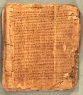
Writing
Papyrus
Writing was easier
Remedies and records were kept
These could be passed on

Slide 8
Religion
Supernatural approach
Gods e.g. Sekhmet
Mummification
Dissection forbidden

Slide 9
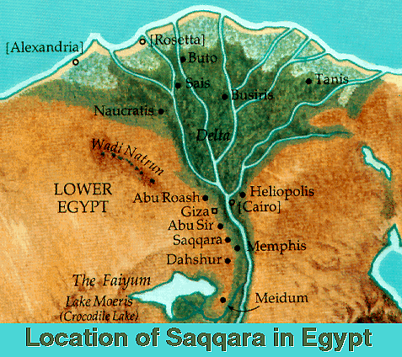
The Nile and Farming
Nile important to way of life
Doctors based medical ideas on the Nile
Channel system

Slide 10
Create a pictogram
How did Life in Egypt affect Medicine?

Slide 11
This powerpoint was kindly donated to www.worldofteaching.com
http://www.worldofteaching.com is home to over a thousand powerpoints submitted by teachers. This is a completely free site and requires no registration. Please visit and I hope it will help in your teaching.

